Slide 1
Cluster Analysis
Isael Corona

Slide 2
Introduction
Smart Contract exploits have been an issue throughout recent years and has been done in several ways (risk tags)
However, some risk tags are more common than others and some risk tags are more likely to appear with other risk tags
In my cluster analysis I will be checking which risk tags are likely appear together and see which ones are likely to be in a group together
I will be using several methods to check for clusters to give several insights while considering the insights from the previous project

Slide 3
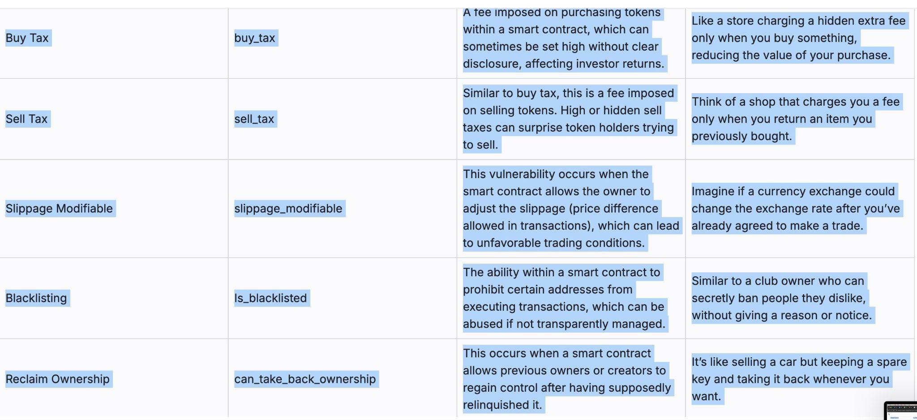
Risk Tags

Slide 4
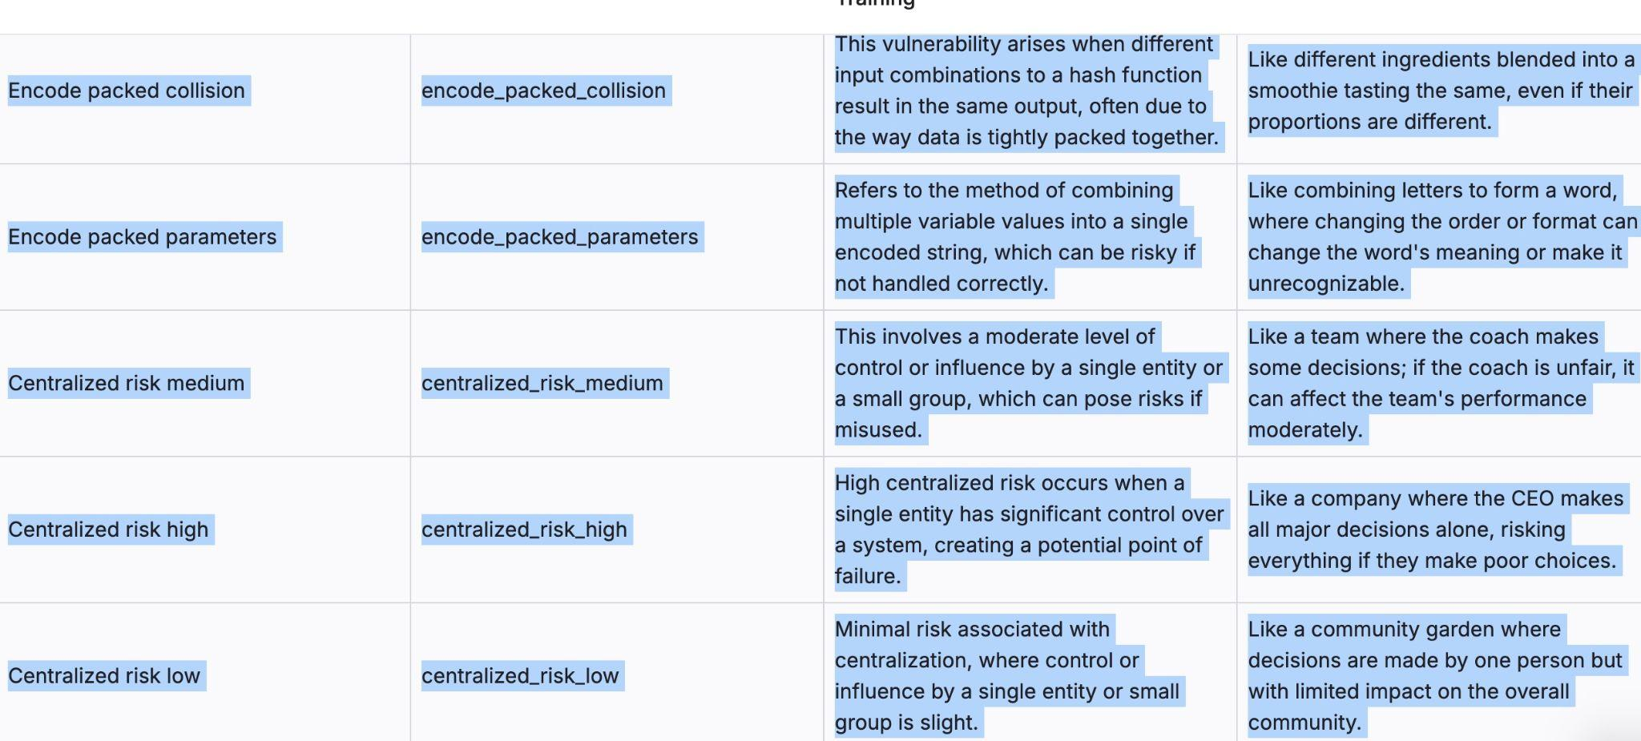
Risk Tags

Slide 5
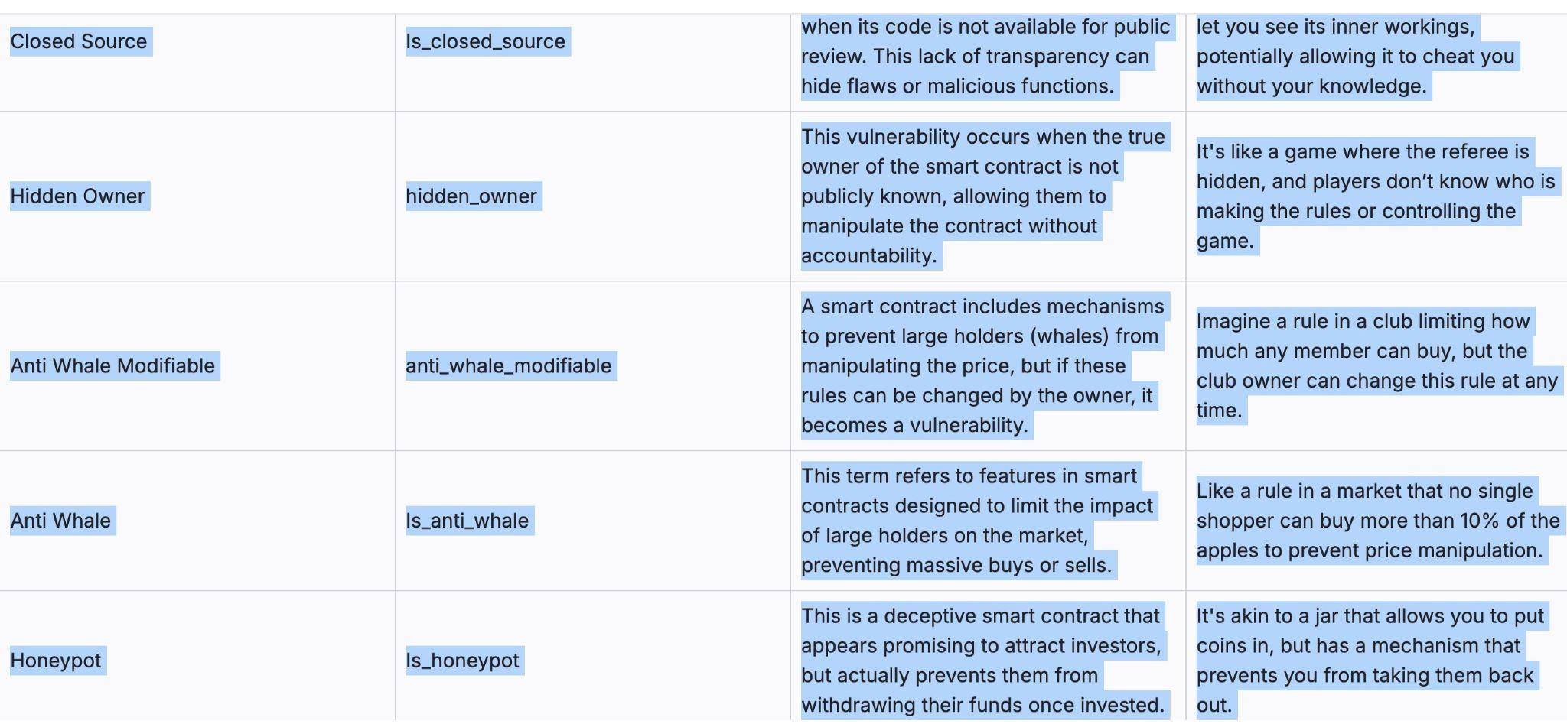
Risk Tags

Slide 6
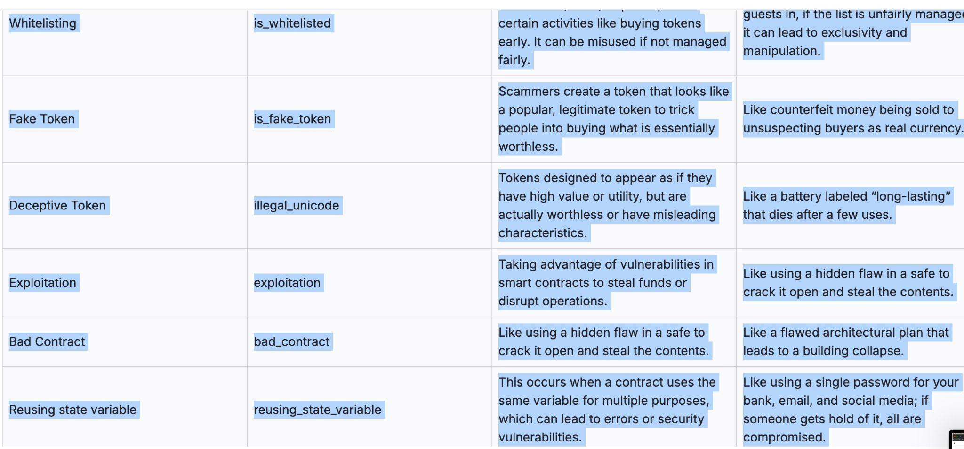
Risk Tags

Slide 7
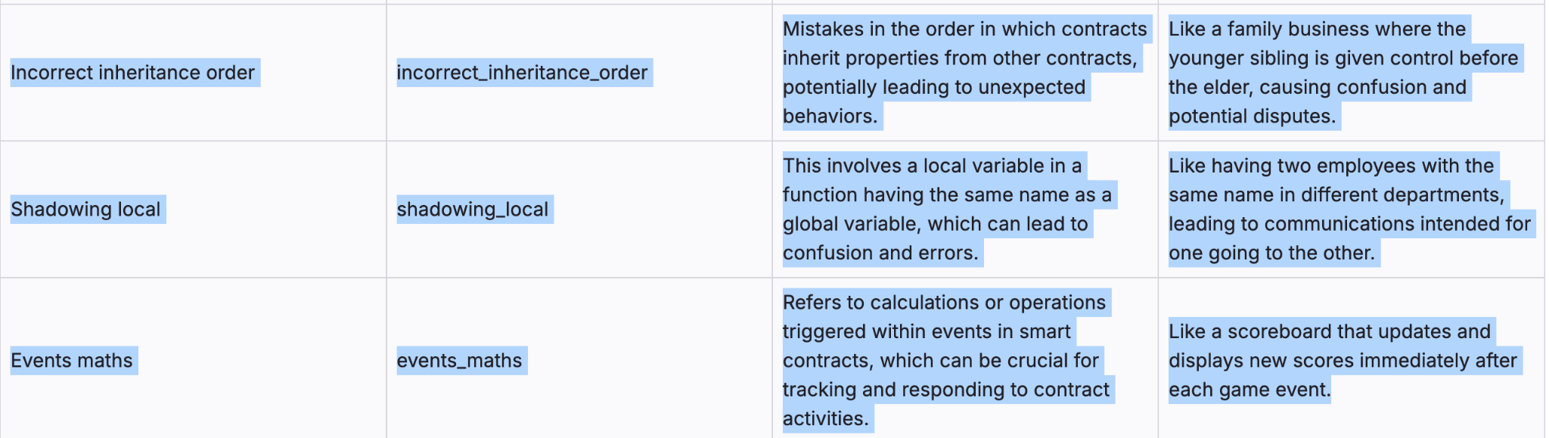
Risk Tags

Slide 8
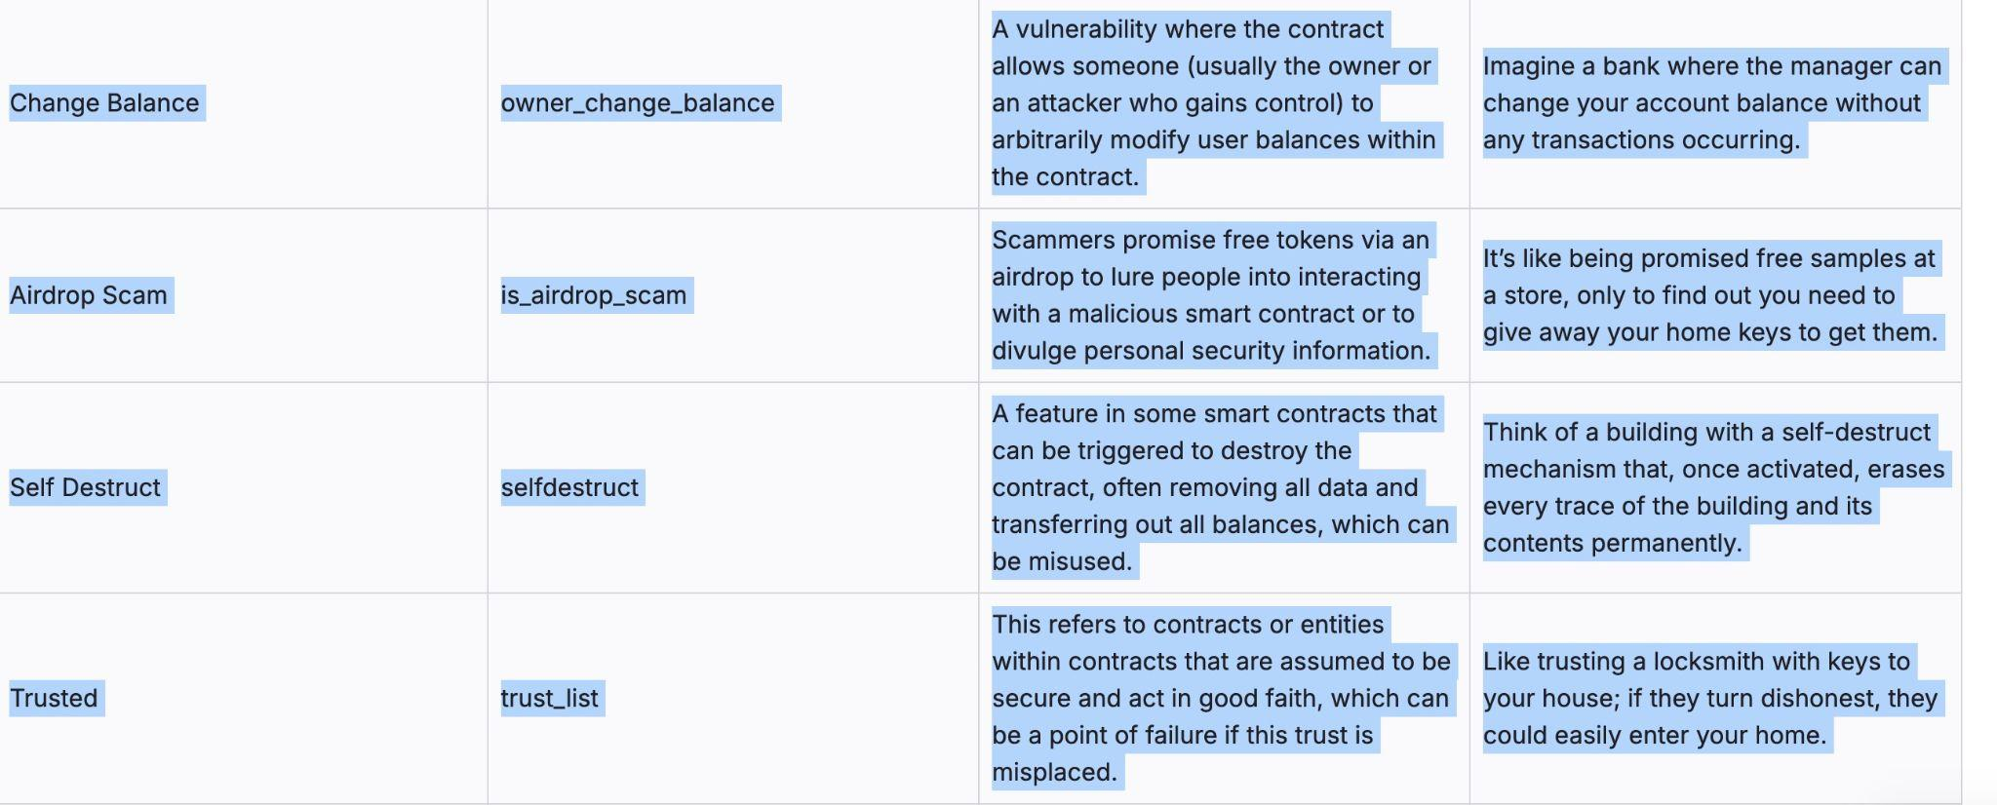
Risk Tags

Slide 9
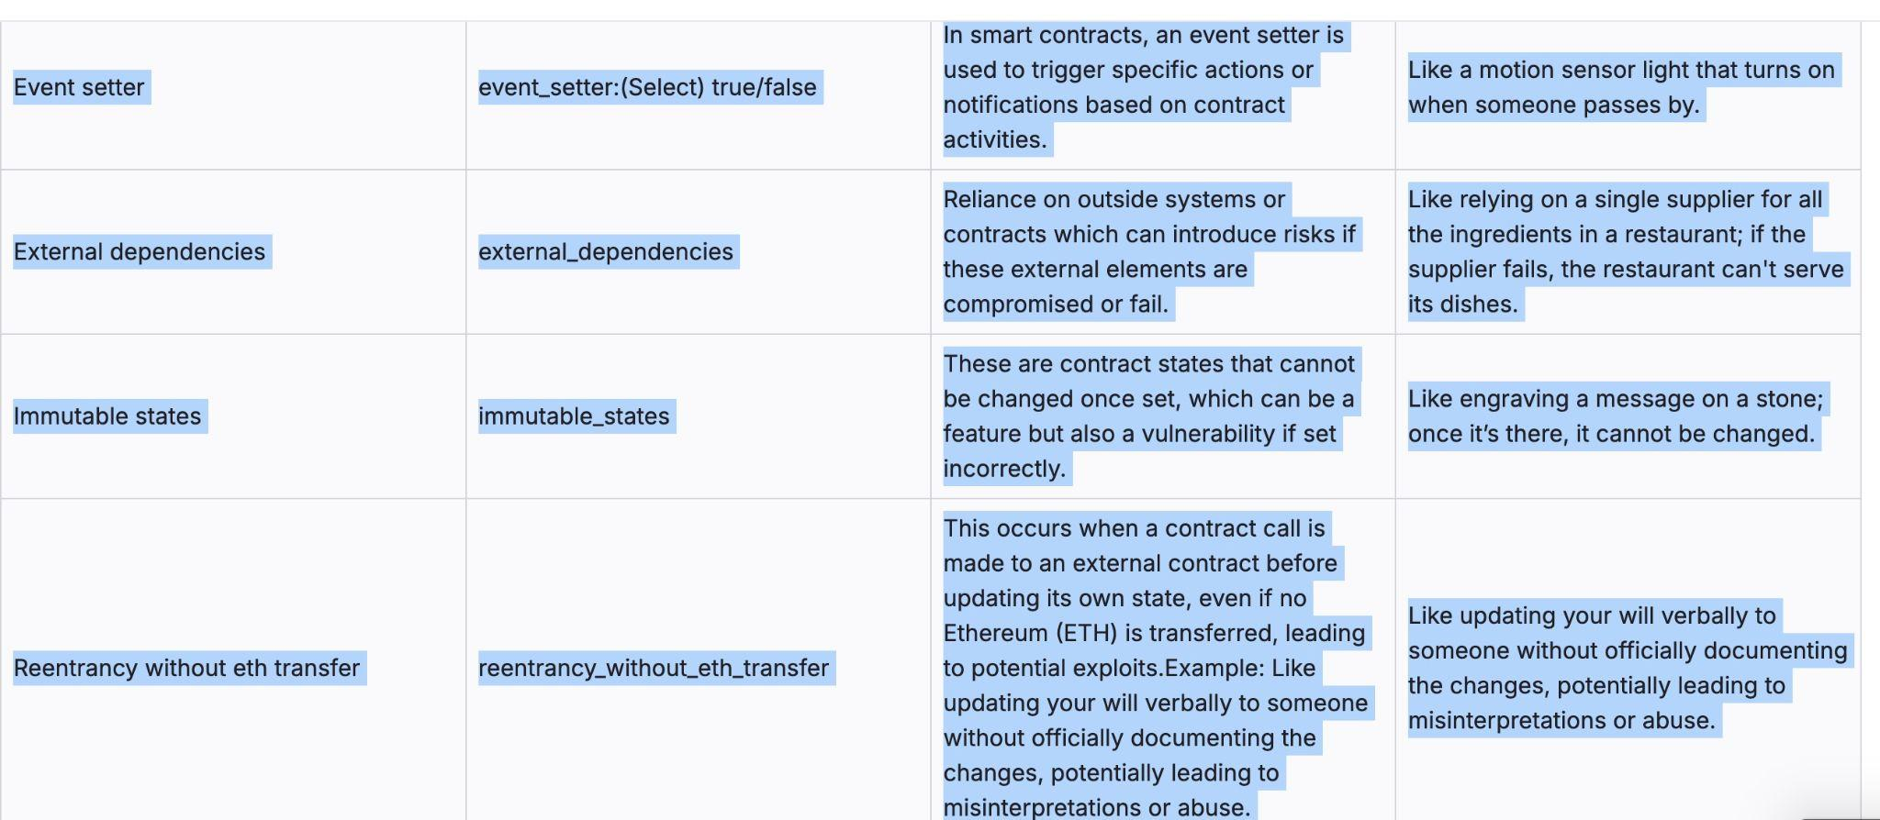
Risk Tags

Slide 10
Cluster Analysis
For the cluster analysis I tested to have clusters of n=3
Considering the prior frequency and correlation analysis, I tested multiple variations of the top and low performing risk tags
I did this to confirm my prior research, gain new insights and to to also try new combos for the risk tags

Slide 11
Cluster analysis for Encode_packed_collision, is_airdrop_scam and is_fake_token

Slide 12
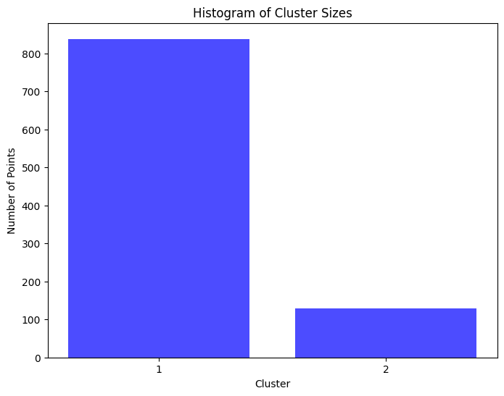

Slide 13
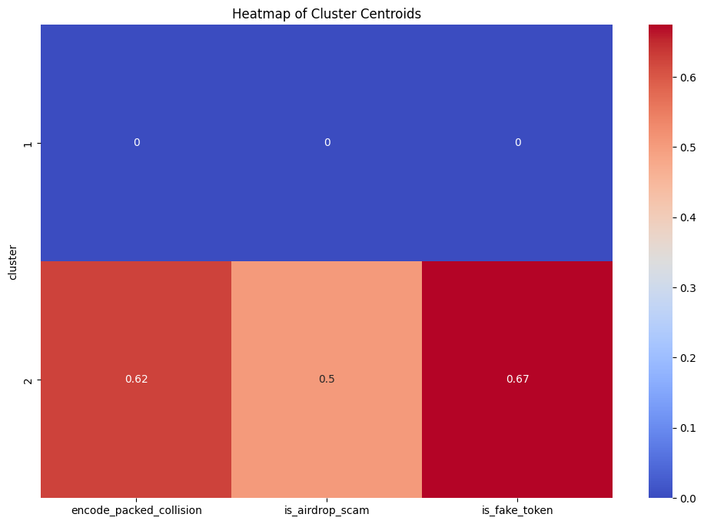

Slide 14
Analysis results
For this combo, I decided to test it because in the correlation analysis these were the tags that came up the most
Similarly, they are also closely related as well in the cluster analysis
In the histogram, when the 3 tags are put together they have a short distance to the centroid of that cluster, implying they are closely related
In the heat map when they are all clustered together they all have a huge presence, particularly is fake token at a .67 frequency
However, airdrop scam and encode packed collision aren’t to far behind at .5 and .62 respectively
I would say that these tags by cluster analysis can be put together

Slide 15
Cluster analysis for exploitation, bad_contract and external dependencies

Slide 16
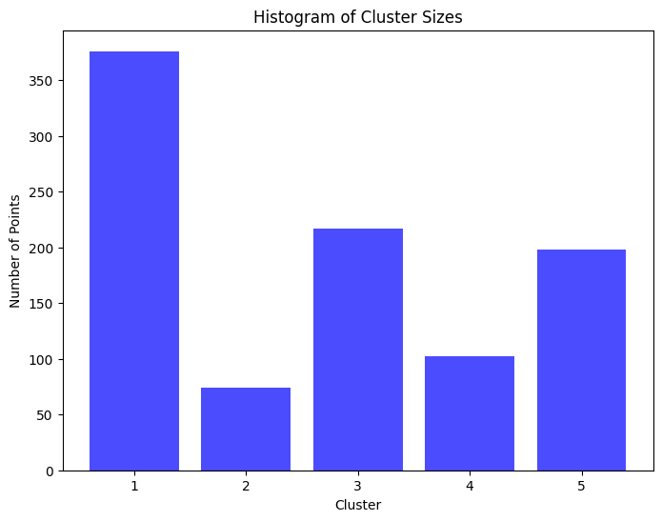

Slide 17
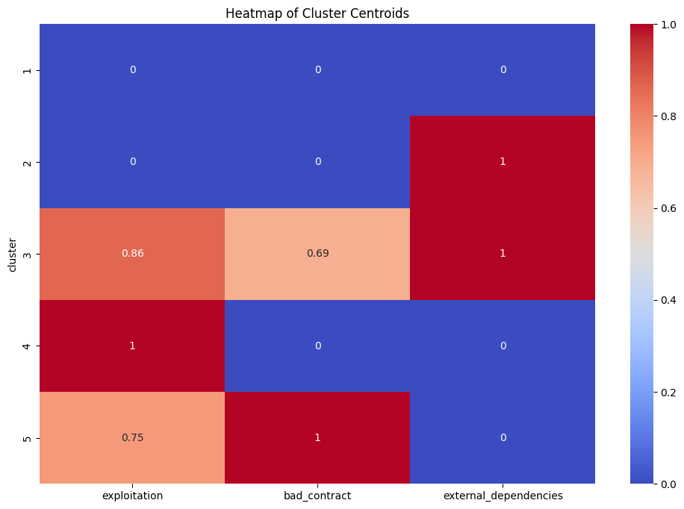

Slide 18
Analysis results
For this combo, I decided to test it because in the frequency analysis these where the top 3 tags that came up
There are 5 clusters for this tag and each one yielded different results. For the histogram clusters 3 & 5 have medium distances and clusters 2 & 4 have short distances
In the heat map analysis some tags were stronger than others in certain clusters such as external dependencies has a score of 1 in clusters 2 and 3 and Bad contract has a score of 1 in cluster 5
The third cluster had had more of a well rounded results as bad contact had a result of .69 and exploitation at .86
I would say these 3 tags are somewhat related

Slide 19
Cluster Analysis for Centralized_medim_risk, owner_change_balance and external_dependencies

Slide 20
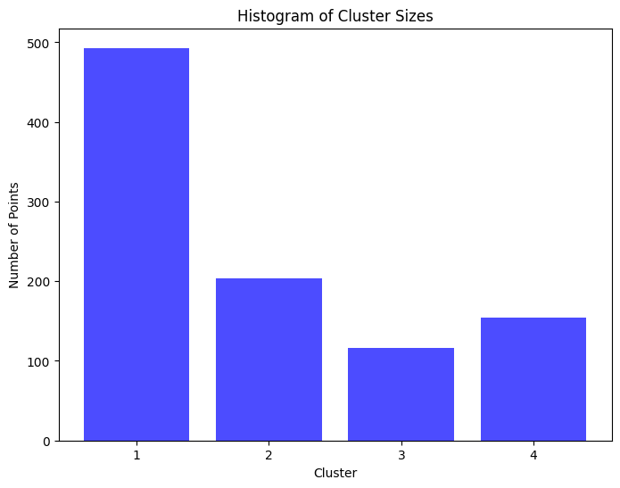

Slide 21
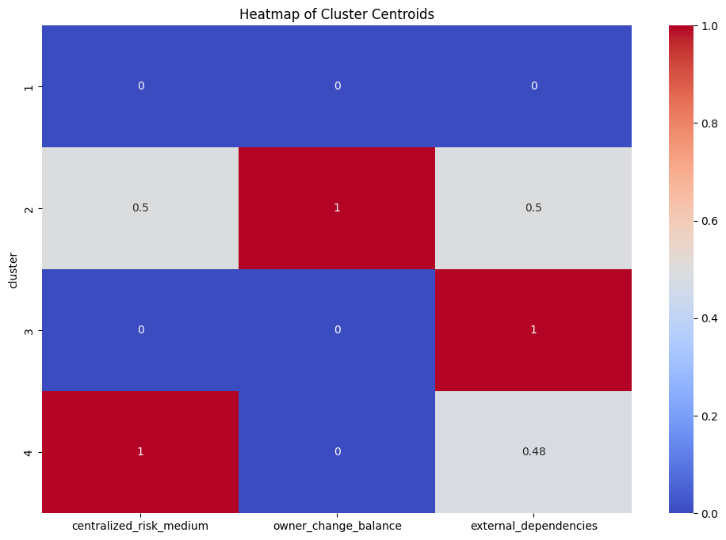

Slide 22
Analysis results
For this combo, I wanted to look into it because these tags were also in the top 5 of the frequency analysis these tags were in positions 3-5
In the Histogram we have 4 clusters each of them having different results ranging from low to high distances from their centroid
However in the heatmap, some of the tags are underperforming
Each tag has a score of 1 from the clusters 2-4 but the additional tags underperform in the clusters
I would say that these 3 tags aren’t related for clustering

Slide 23
Cluster analysis for bad_contract, owner_change_balance, encode_packed_collision

Slide 24
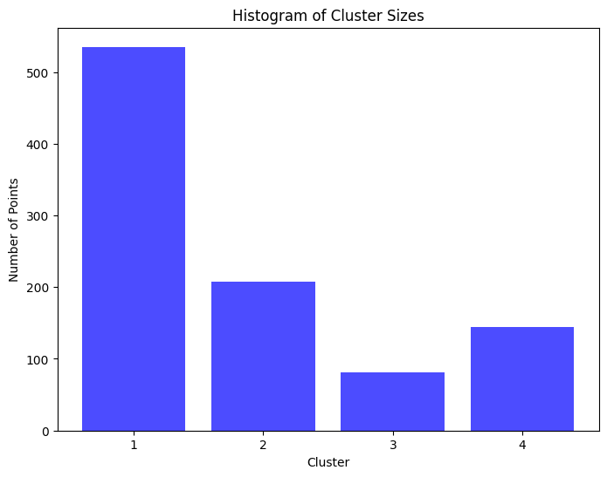

Slide 25
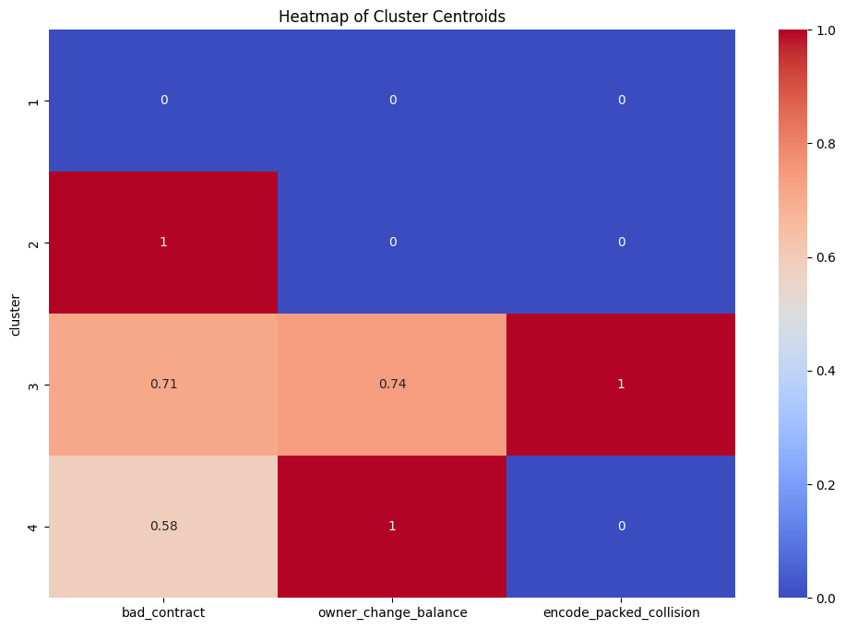

Slide 26
Analysis results
I decided to study this combo because I wanted to mix some high performing tags from the frequency analysis and 1 low performing tag that did well in the correlation analysis, encode packed collision
In the histogram we have 4 clusters where 3 of the clusters have a smaller distance to its centroid
In the heat map across the several clusters we have some range where the tags have higher frequencies and some that have less of a frequency
In particular in the third cluster encode packed collision has a score of 1 and owner change balance and bad contract have a score of .74 and .71 respectively
I would say these 3 can be clustered together and have correlation

Slide 27
Cluster analysis for illegal_unicode, encode_packed_collision and is_airdrop_scam

Slide 28


Slide 29
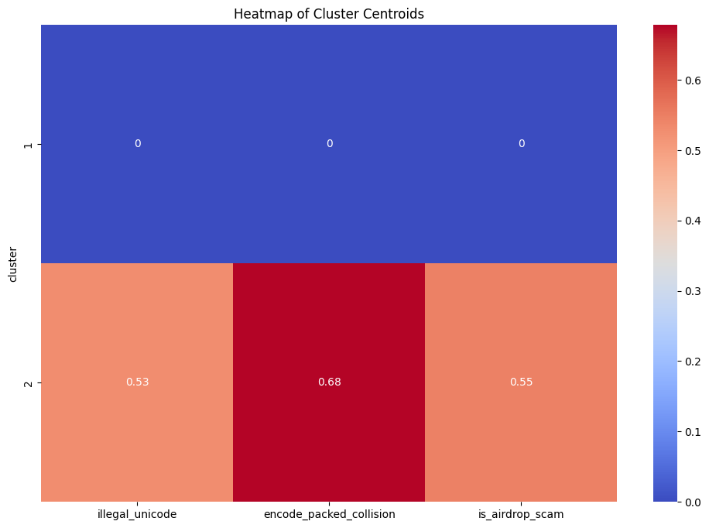

Slide 30
Analysis results
For this combo, I decided to check 2 tags from the correlation that had some presence in the top 10 clusters with the most popular tag in the correlation analysis
For this analysis we had 2 clusters and the second cluster has a small distance to its centroid implying closeness
In our heat map, we feel the presence of encode packed collision at .68 then airdrop scam at .55 and illegal unicode at .53
In our case these risk tags can be clustered and have similar traits and can appear together

Slide 31
Cluster Analysis for is_fake_token, shadowing_local and reentry_without_eth_transfer

Slide 32
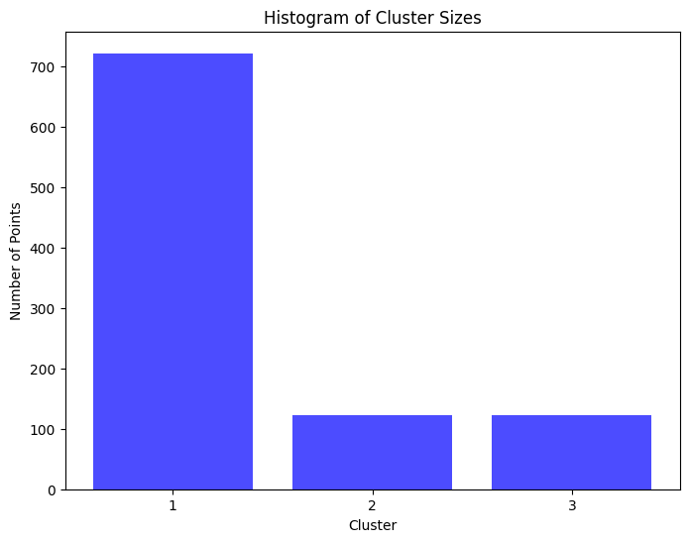

Slide 33
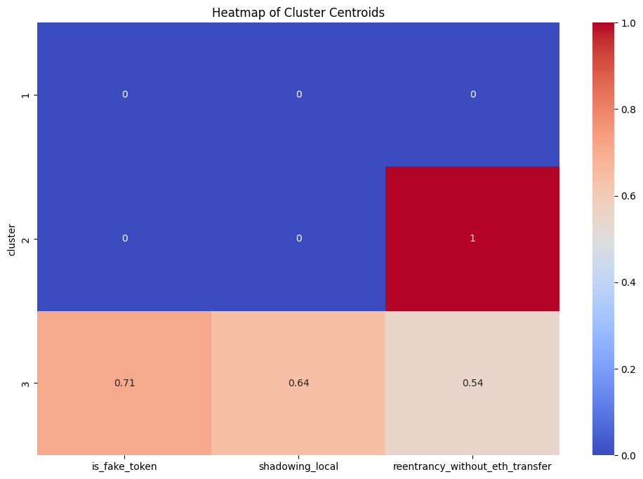

Slide 34
Analysis results
For this following combo I decide to risk tags that came from the bottom 5 from the least appeared risk tags in the frequency analysis
In our analysis we had 3 clusters and in the histogram the 2nd and 3rd clusters have short distances to their centroid
In our heat graph in the second cluster reentry without eth transfer had a strong presence having a score of 1 and in the third cluster is fake token had the strongest presence at .71 then shadowing local at .64 and reentry at .54
These tags can be clustered but it doesn’t have the strongest connection

Slide 35
Conclusion
Even though there was some similarities between the frequency/correlation analysis and the cluster analysis there were also differences
What made the cluster analysis different from my precious work was that I tested 3 tags at a time vs in the correlation analysis we would check for 2 at a time
For example the most popular combo in my correlation analysis encode packed collision, airdrop scam and fake token did have similar results in the cluster analysis
However for combos the in the frequency analysis they didn’t have good results such as the central risk medium, owner change balance and external dependencies

